Slide 1
Global Ecological Trends of Lignification in the Xylem
Fritz Schweingruber, Patrick Züst 18.02.2016

Slide 2
The Dataset
Classified Slides 4707
Analyzed Slides 2720

Slide 3
What do we want to find out?
Lignification
Age Estimate
Growth Form (?)
Anatomical Feature
Altitudinal Belt
Plant Height
Vegetation Zone

Slide 4
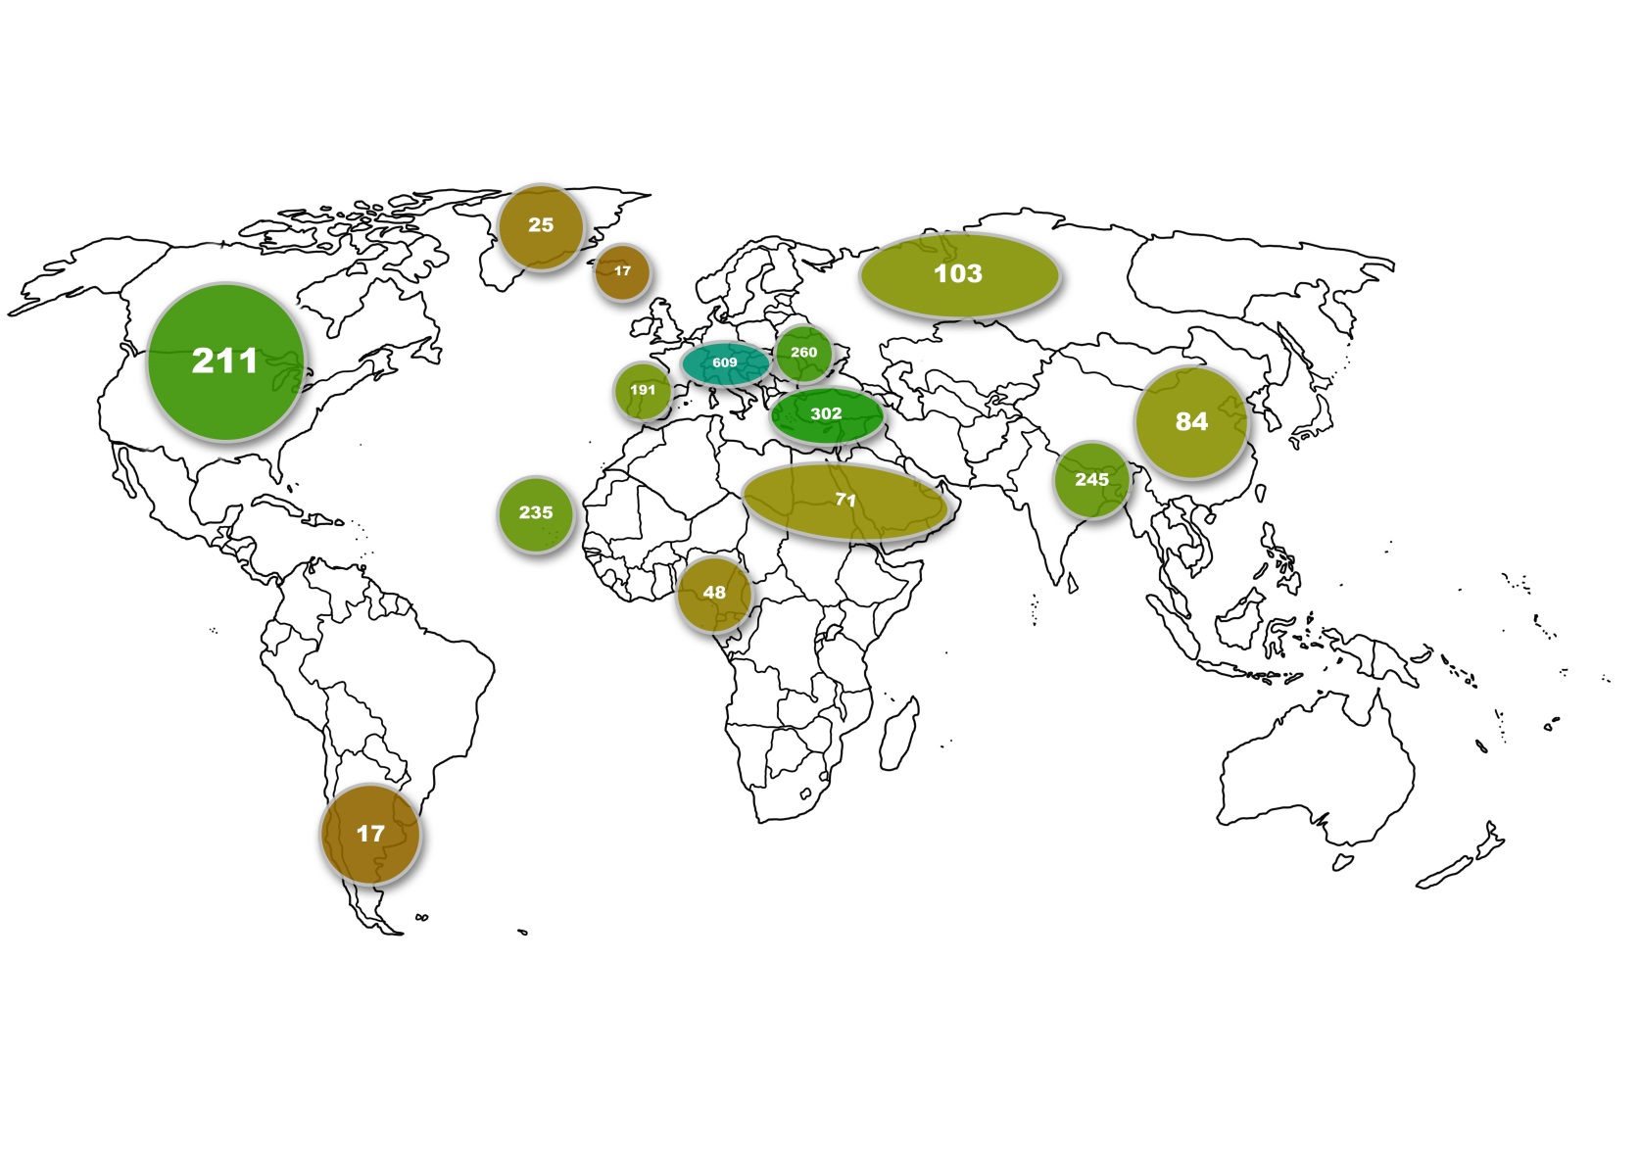
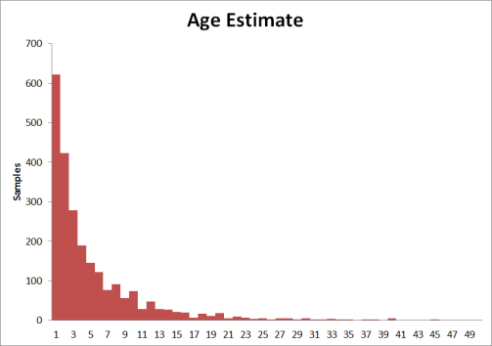
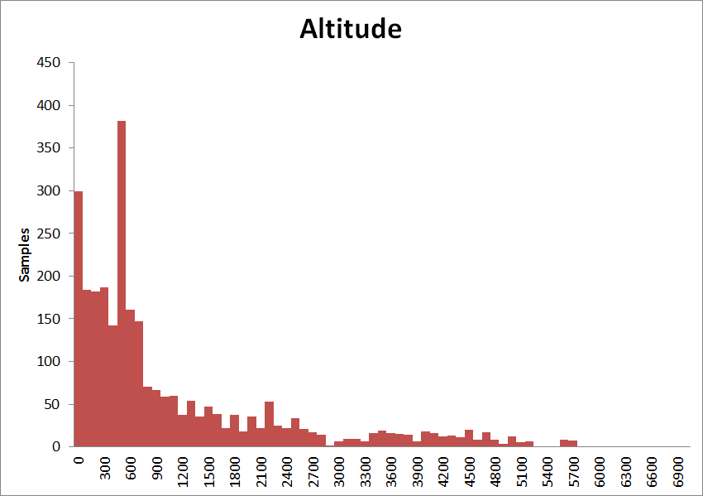
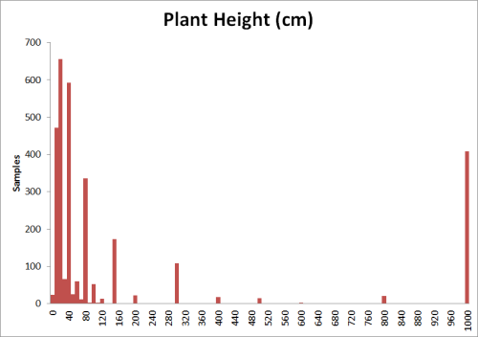
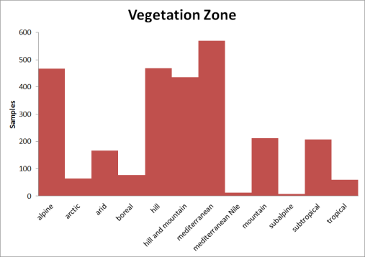
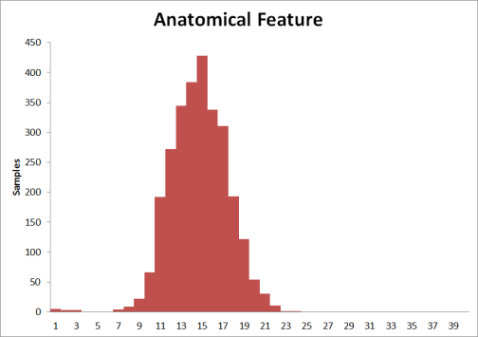
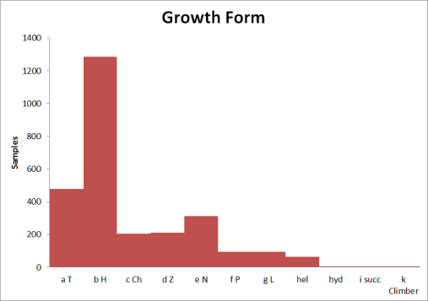

Slide 5
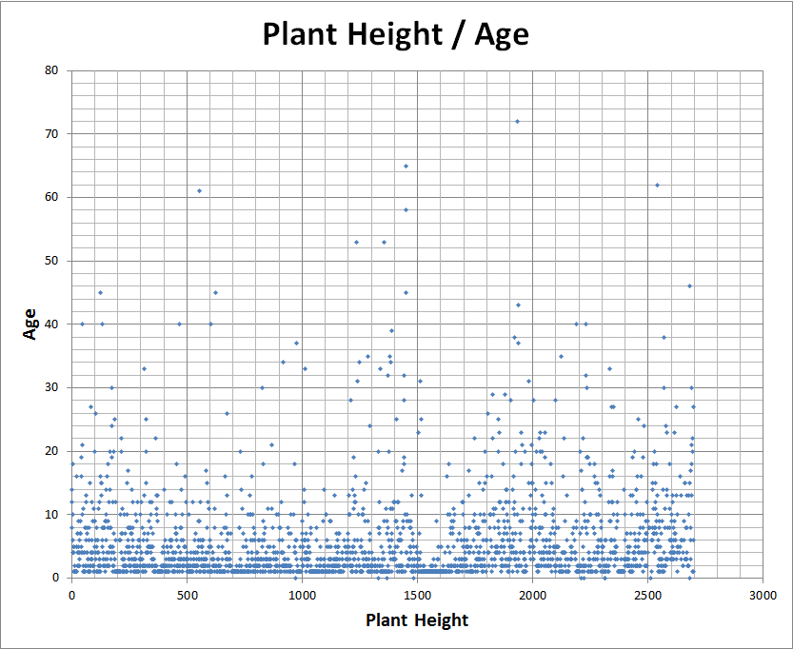
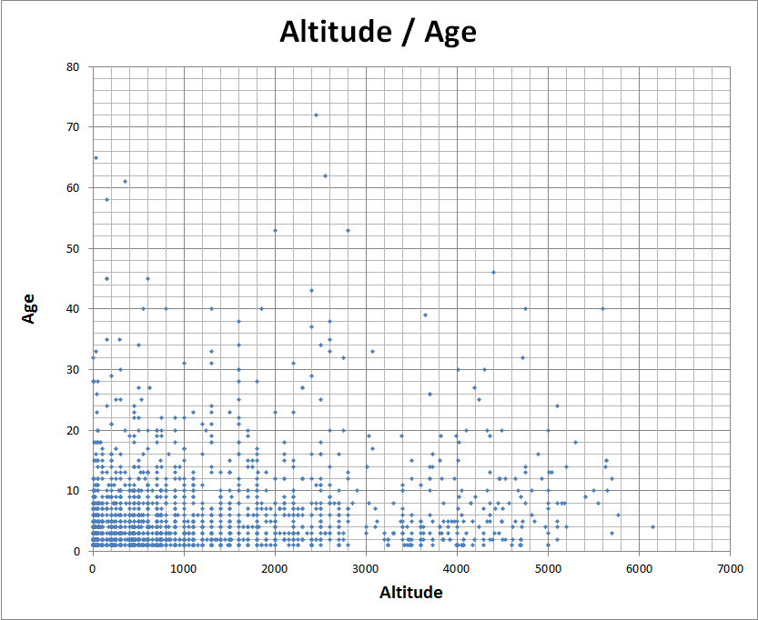
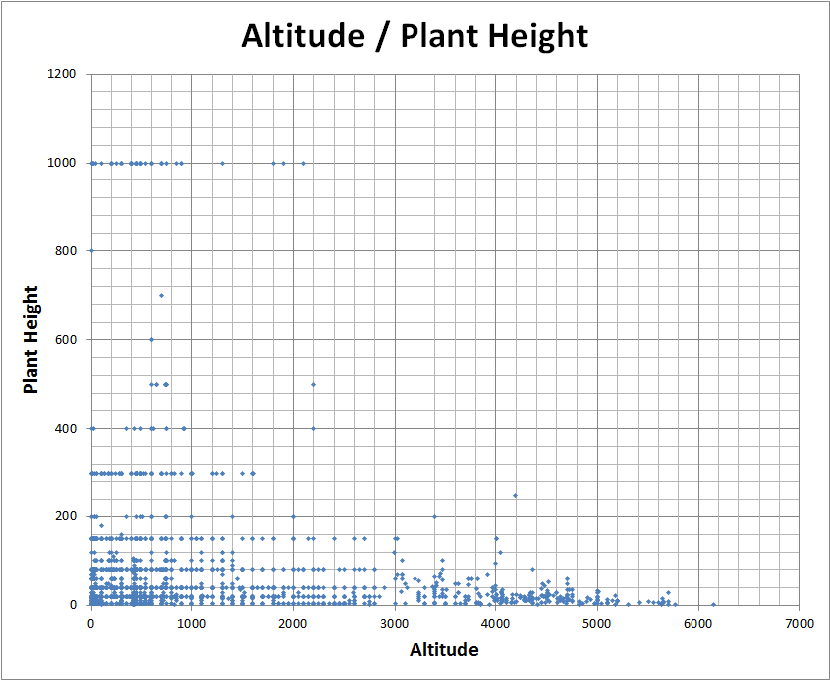
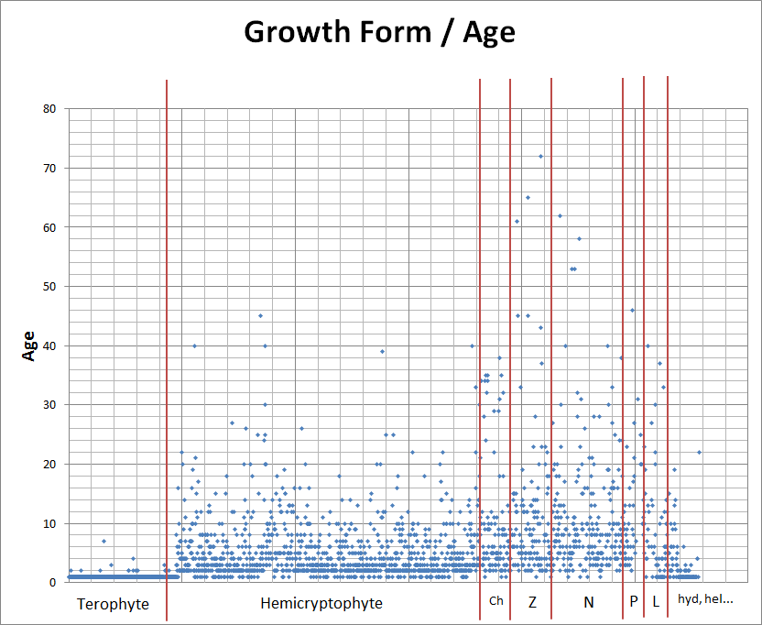
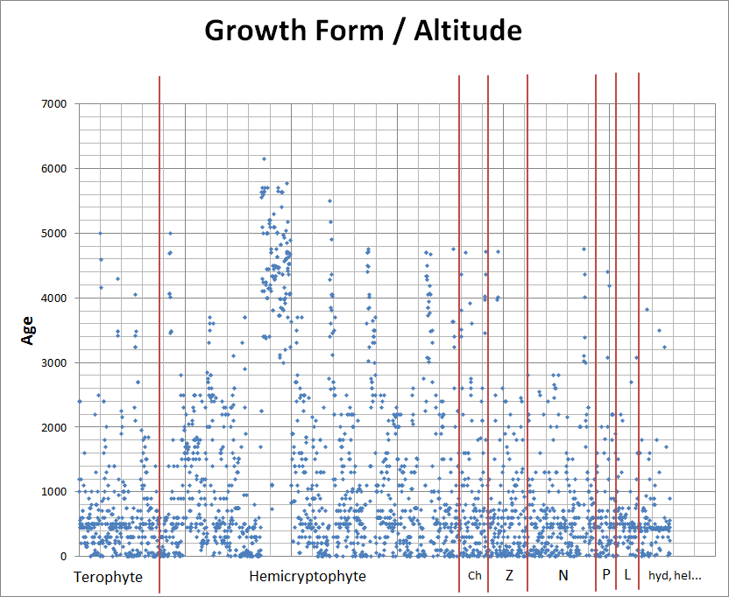
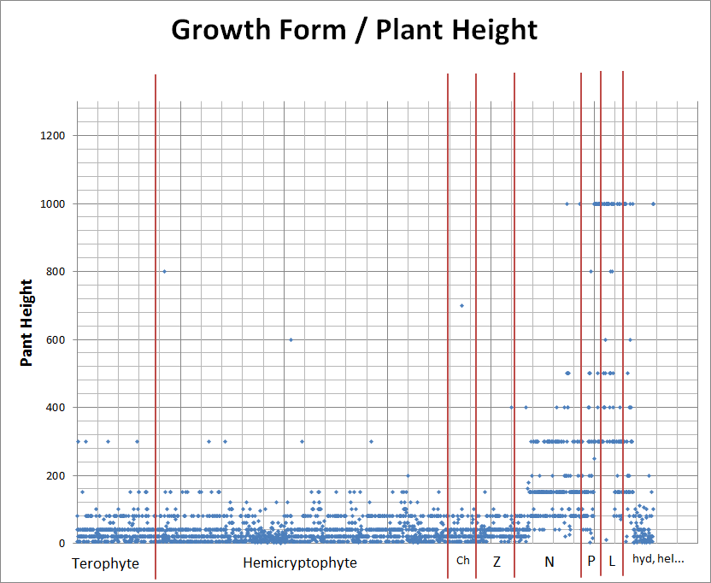

Slide 6
What is Lignin?
What do we know about Lignin?

Slide 7
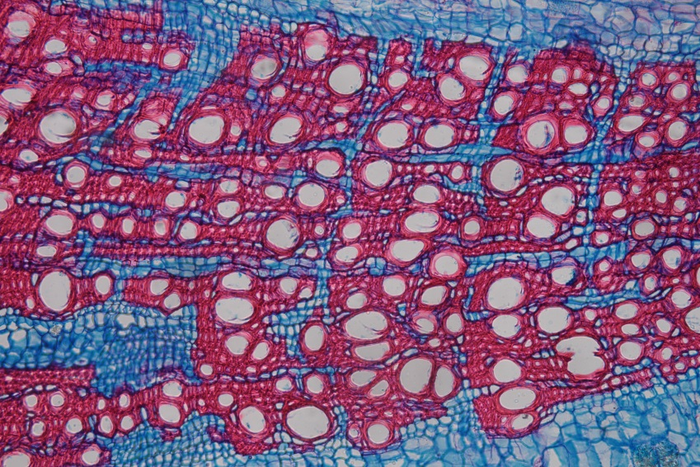
Double-Stained Slides
Safranin
stains
lignified tissues
red
Astra Blue stains
non-lignified tissues
blue
163_58_Convolvulus_cantabrica

Slide 8
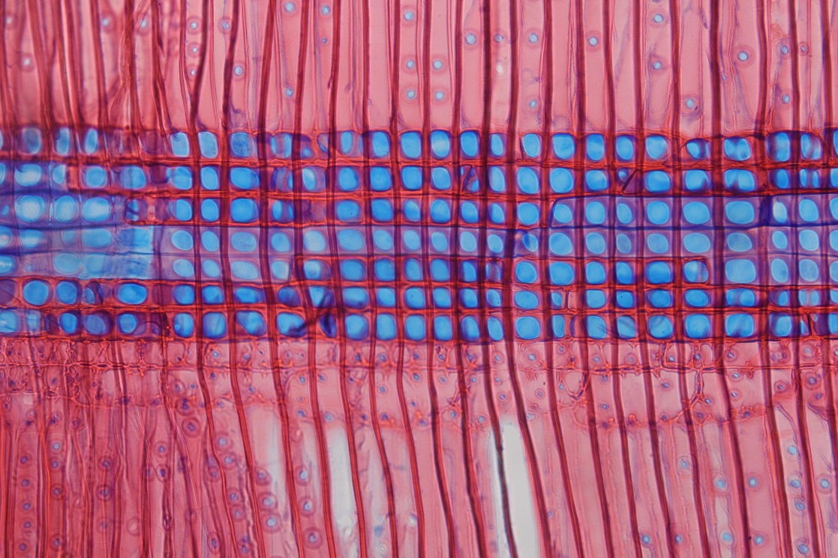
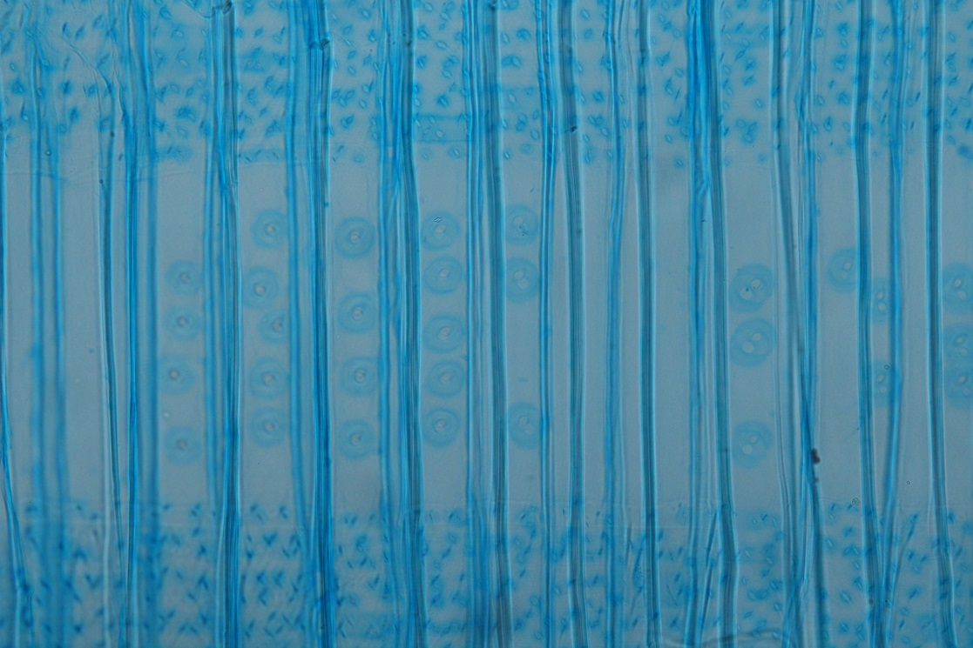
Double-Stained Slides

Slide 9
Methods

Slide 10
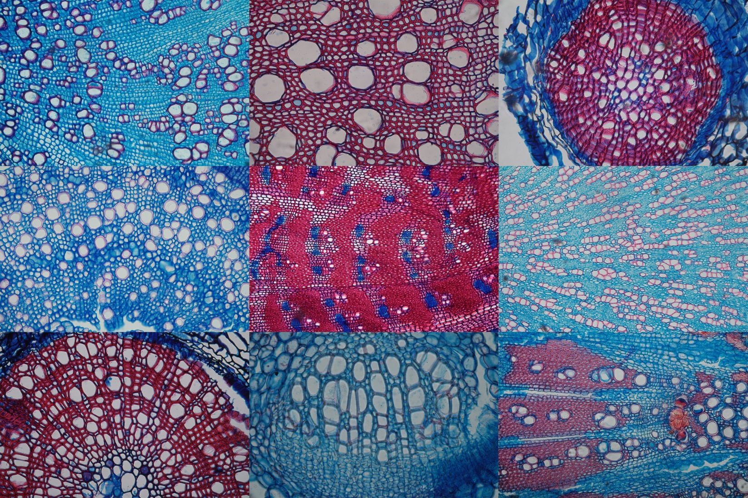
Photographs

Slide 11
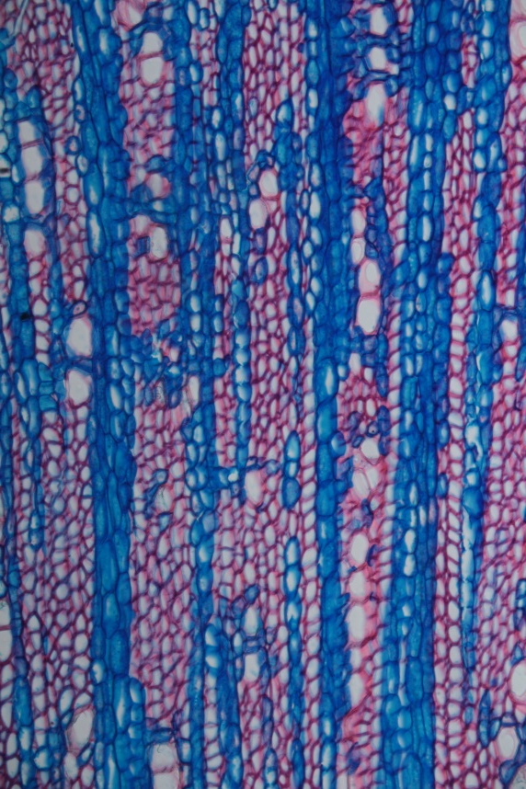
Color Analysis

Slide 12
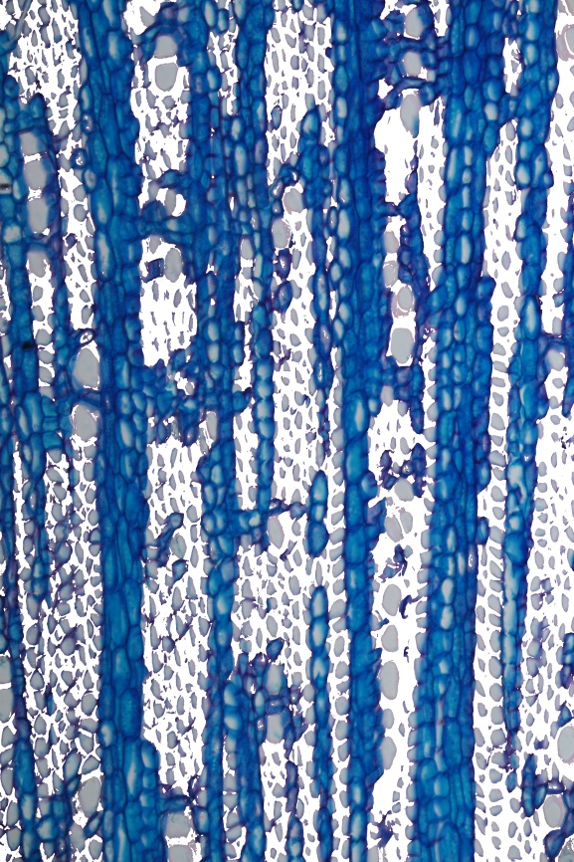
Color Analysis
Configuration | Red
Hue | 0 – 40 & 189 - 255
Saturation | 40 - 255
Brightness | 40 - 255

Slide 13
Color Analysis
Configuration | Red
Hue | 0 – 40 & 189 - 255
Saturation | 40 - 255
Brightness | 40 - 255

Slide 14
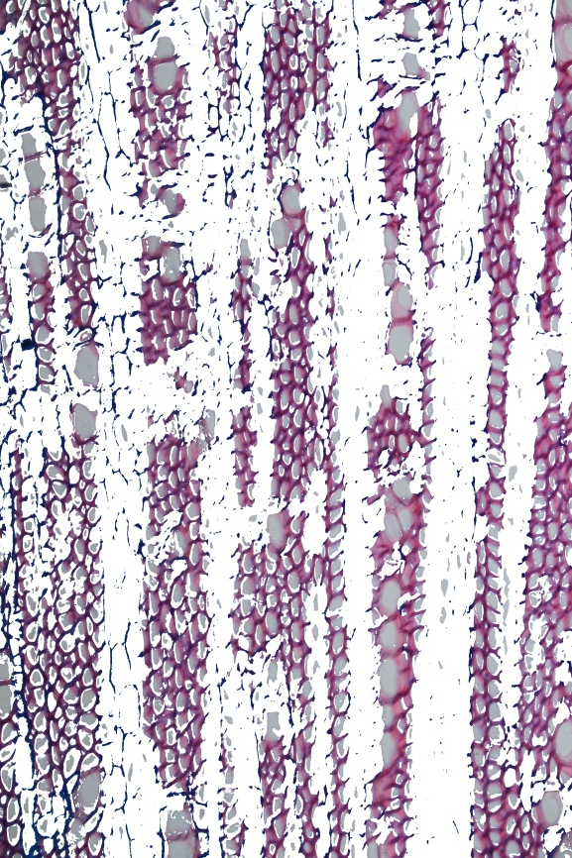
Color Analysis
Configuration | Red
Hue | 0 – 40 & 189 - 255
Saturation | 40 - 255
Brightness | 40 - 255
Configuration | Red
Hue | 125 - 189
Saturation | 40 - 255
Brightness | 120 - 255

Slide 15
Color Analysis
Configuration | Red
Hue | 0 – 40 & 189 - 255
Saturation | 40 - 255
Brightness | 40 - 255
Configuration | Red
Hue | 125 - 189
Saturation | 40 - 255
Brightness | 120 - 255

Slide 16
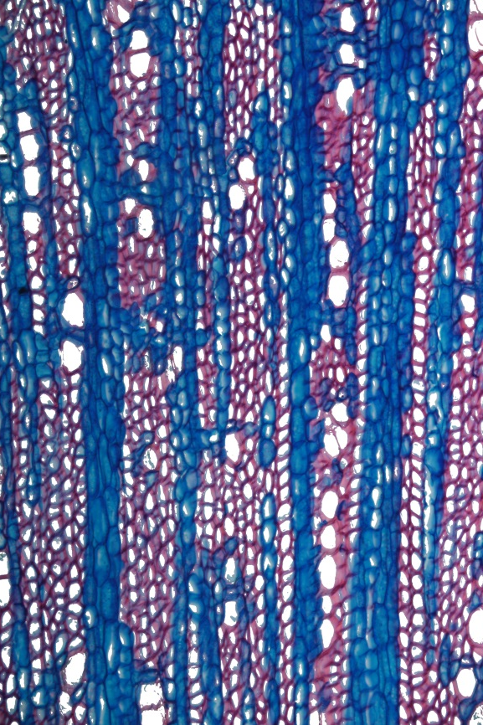
Color Analysis
Configuration | Red
Hue | 0 – 40 & 189 - 255
Saturation | 40 - 255
Brightness | 40 - 255
Configuration | Red
Hue | 125 - 189
Saturation | 40 - 255
Brightness | 120 - 255
Configuration | White
Hue | 0 - 255
Saturation | 0 - 40
Brightness | 120 - 255

Slide 17
Color Analysis
Configuration | Red
Hue | 0 – 40 & 189 - 255
Saturation | 40 - 255
Brightness | 40 - 255
Configuration | Red
Hue | 125 - 189
Saturation | 40 - 255
Brightness | 120 - 255
Configuration | White
Hue | 0 - 255
Saturation | 0 - 40
Brightness | 120 - 255

Slide 18
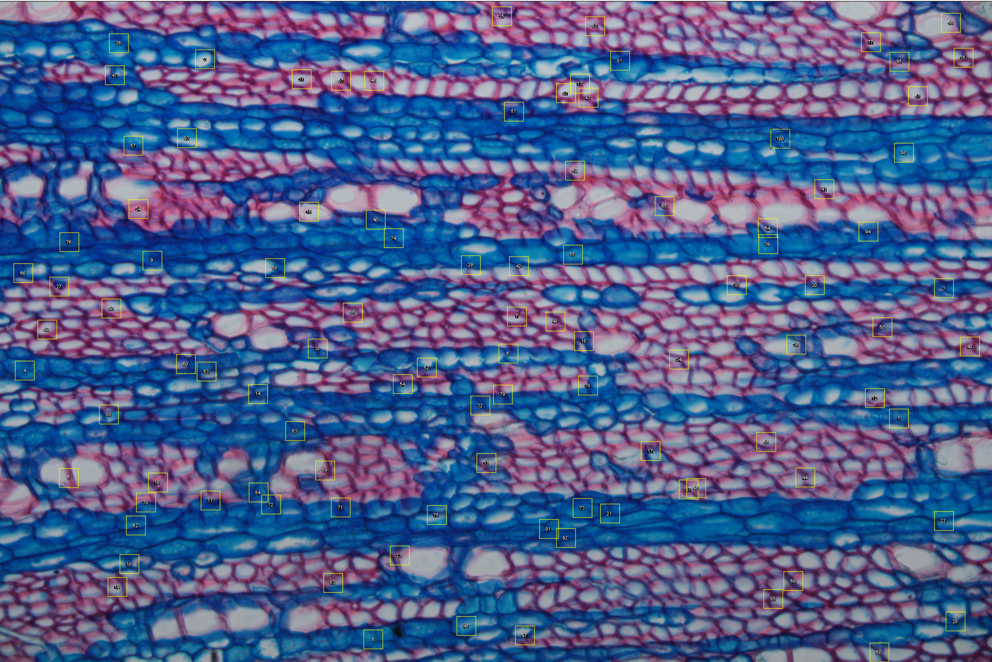

Slide 19
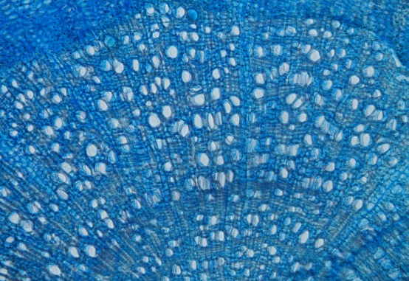
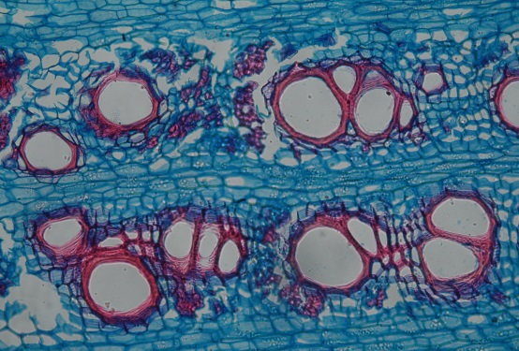
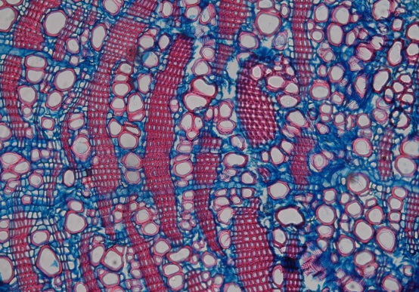
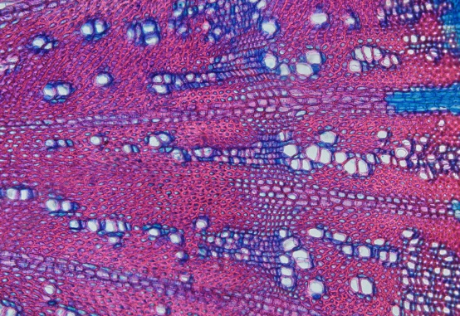
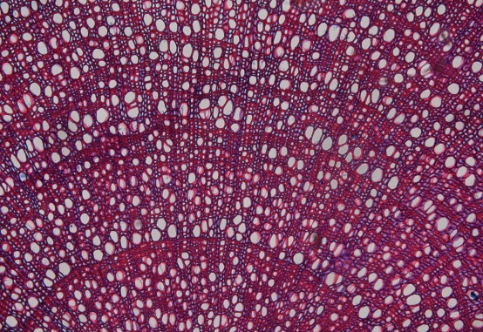
Classification
Proportions
( % red)
__________________________
( % blue)
1 | 2 | 3 | 4 | 5
< 0.5 | 0.5 - 1 | 1 - 2 | 2 - 10 | > 10

Slide 20
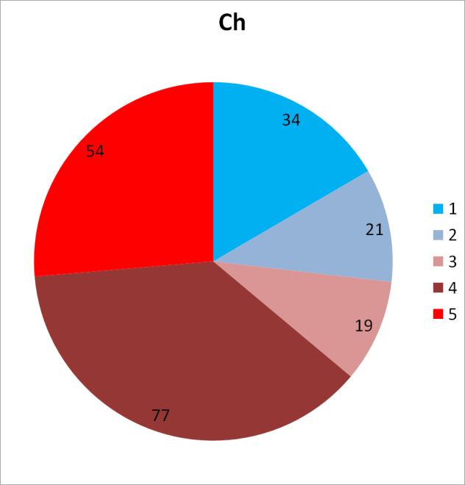
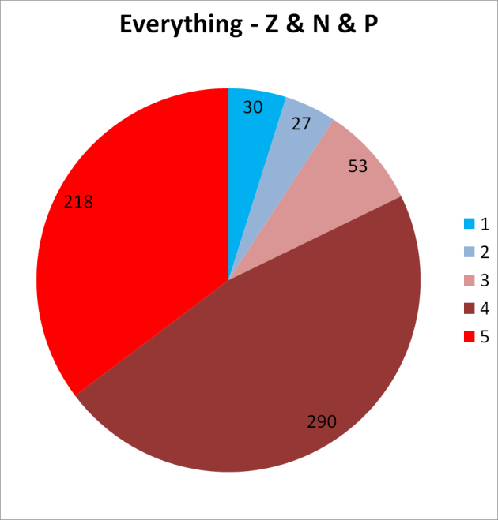
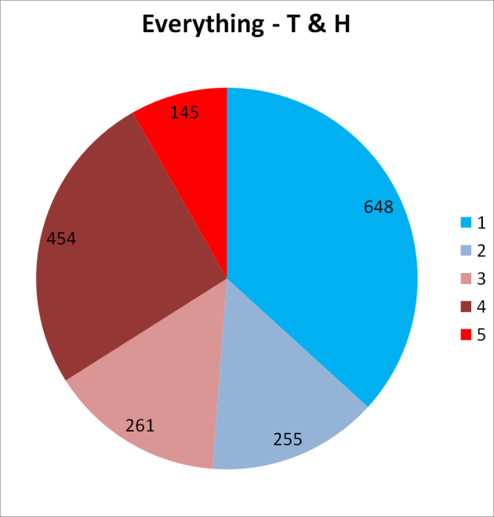
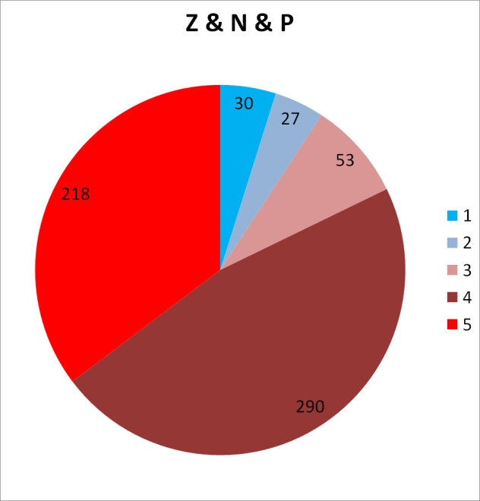
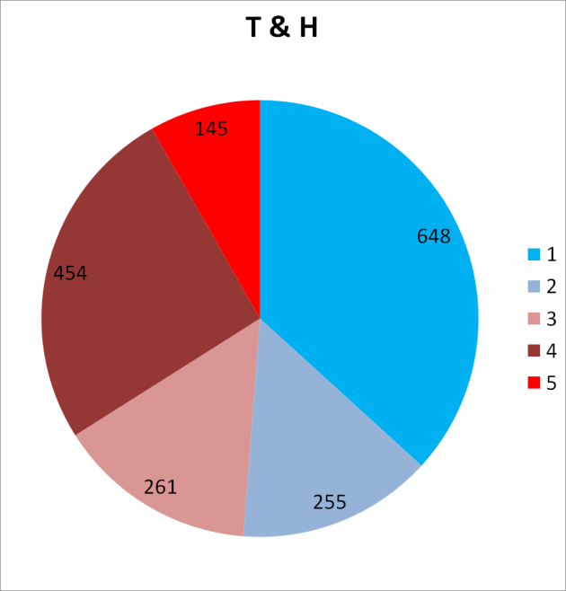
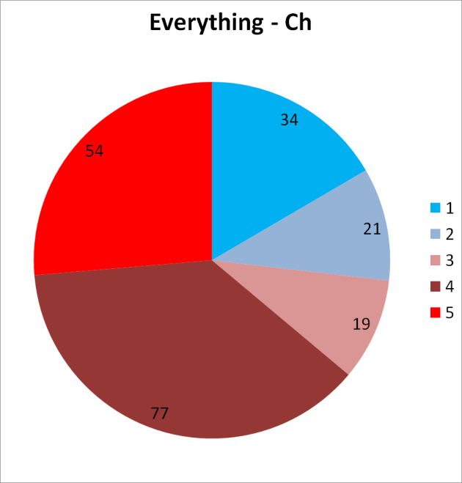
Growth Forms

Slide 21
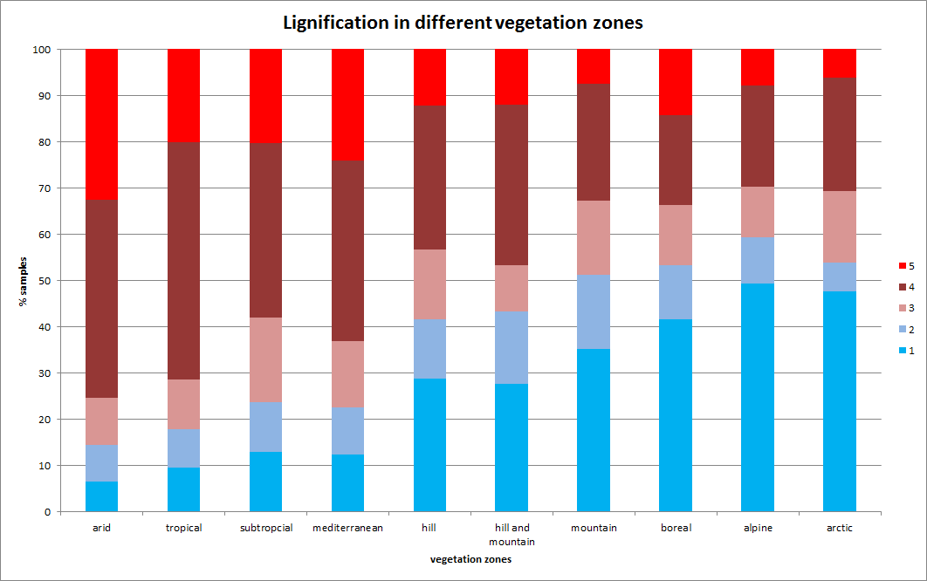
Vegetation Zone

Slide 22
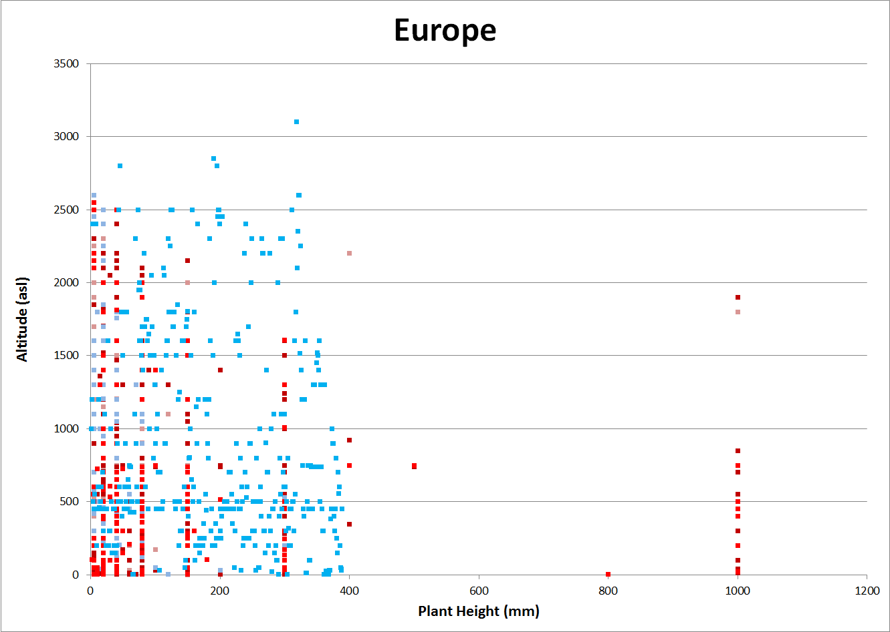
Altitude / Plant Height

Slide 23
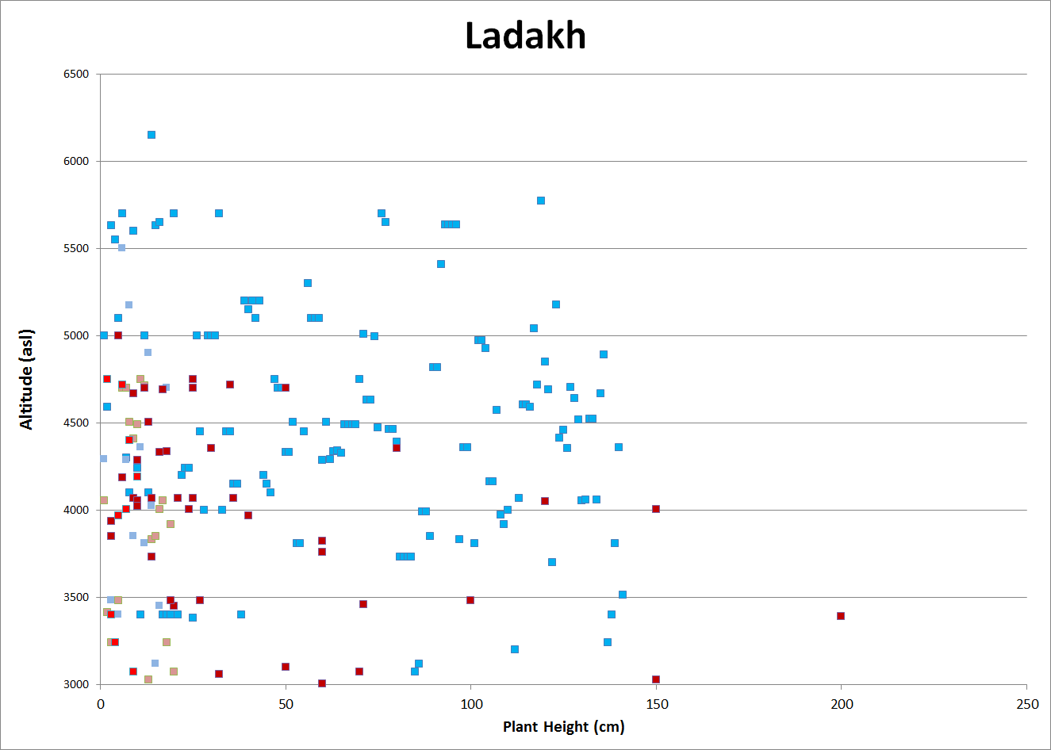
Altitude / Plant Height

Slide 24
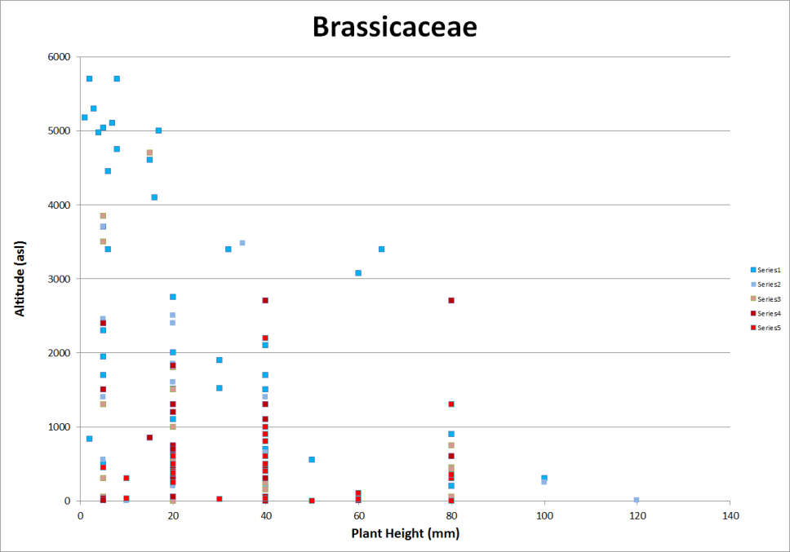
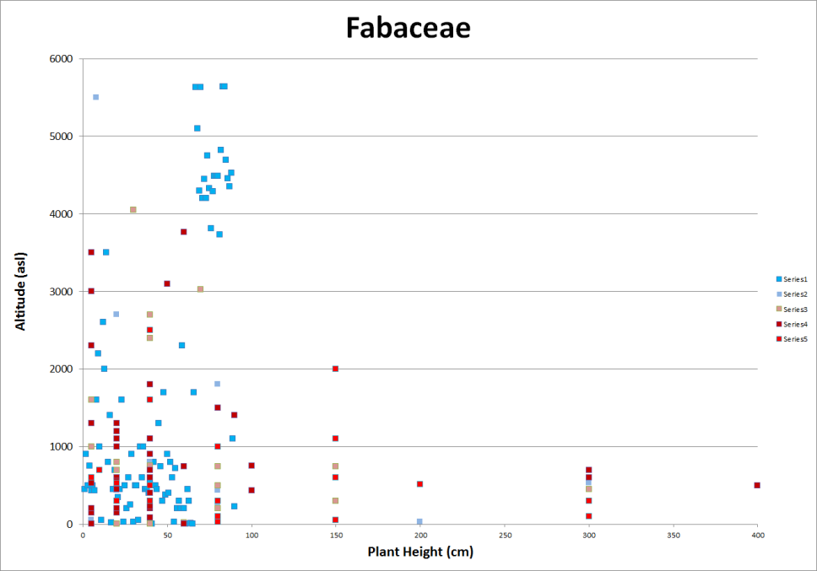

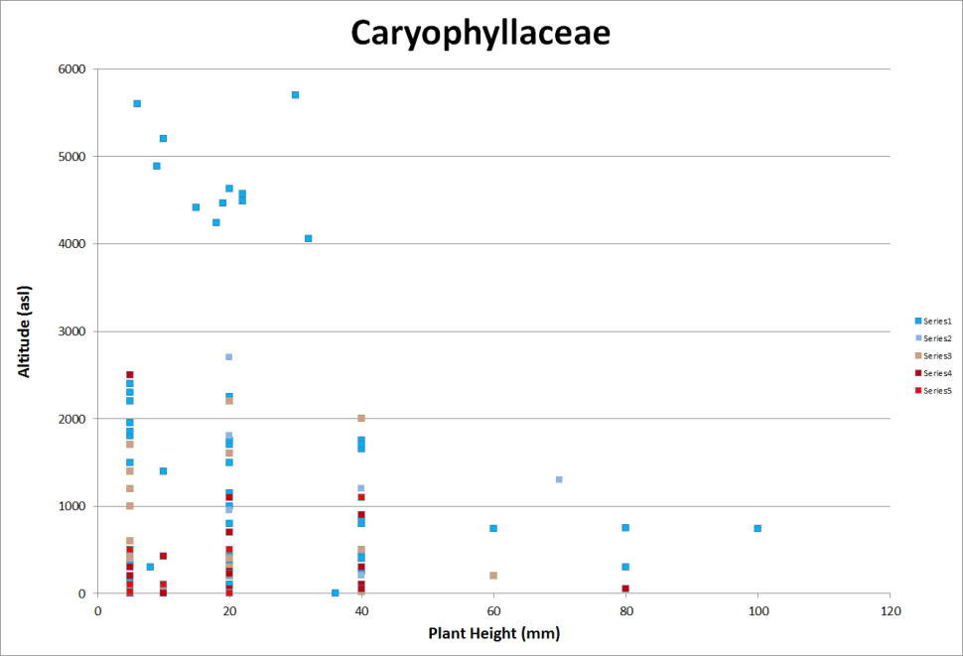
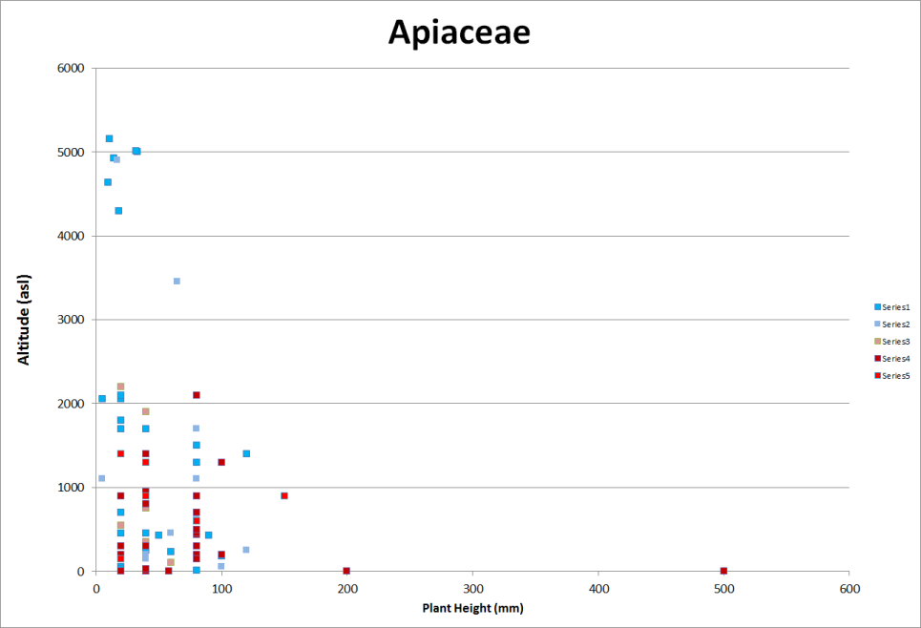

Slide 25
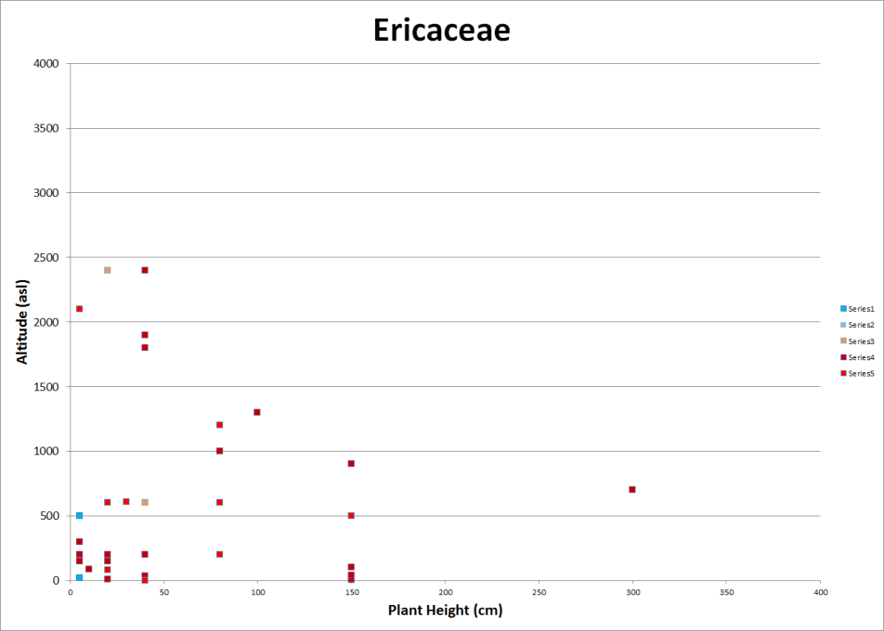
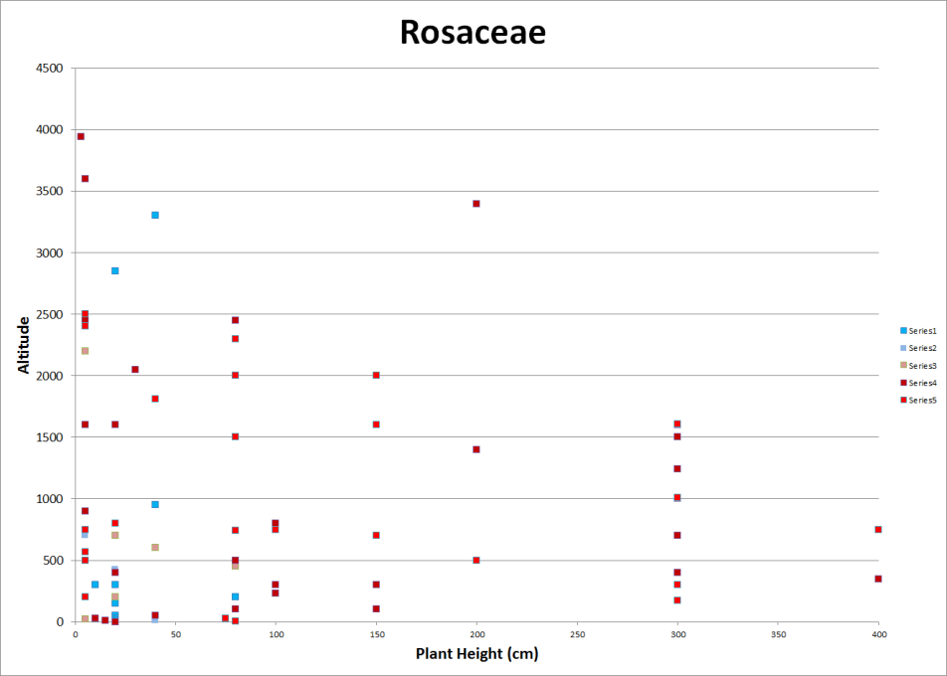
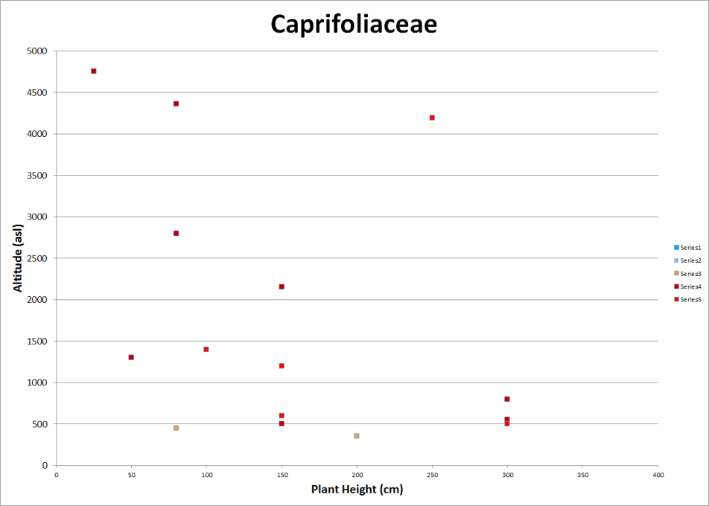
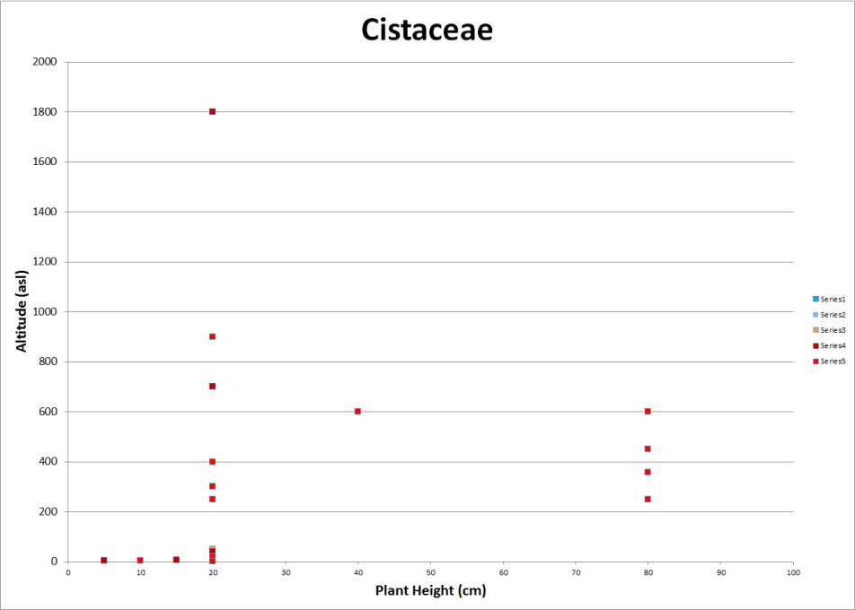

Slide 26
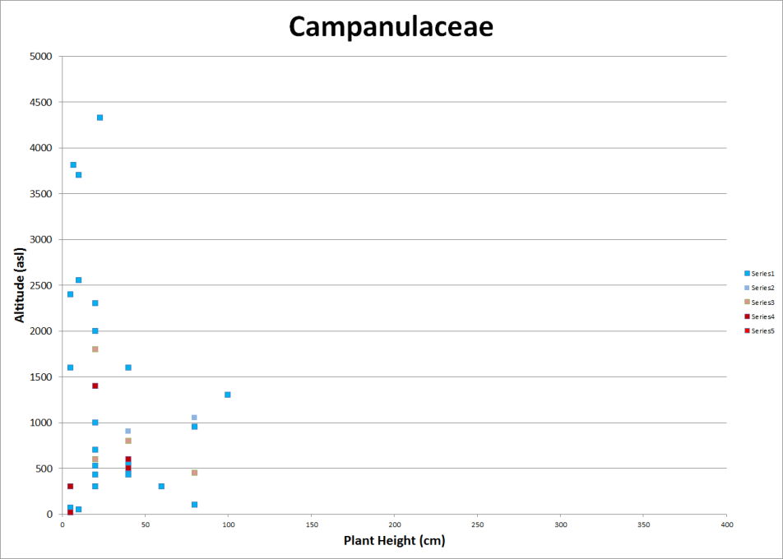
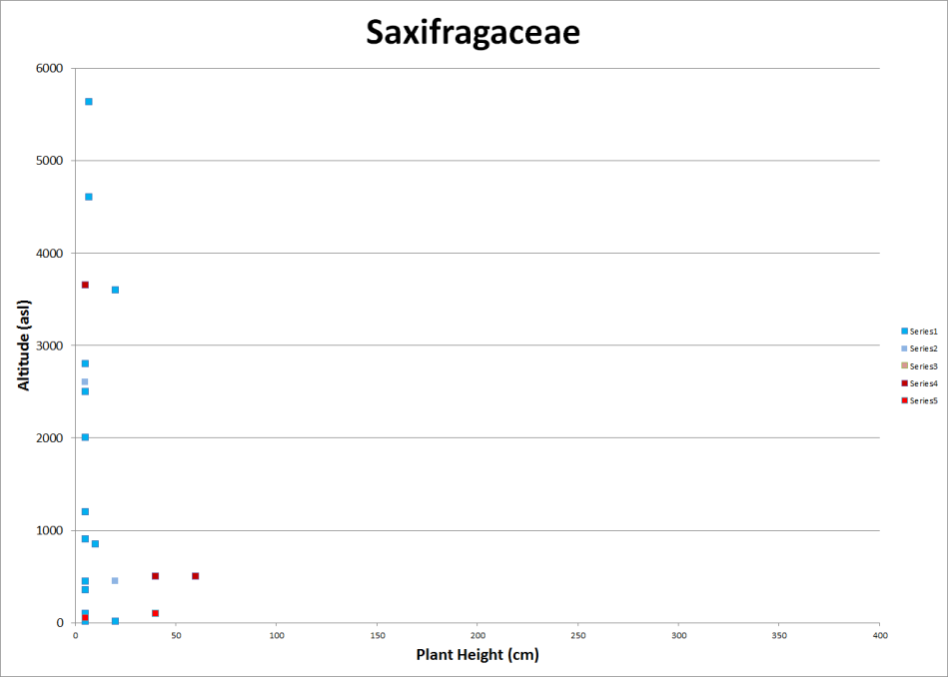
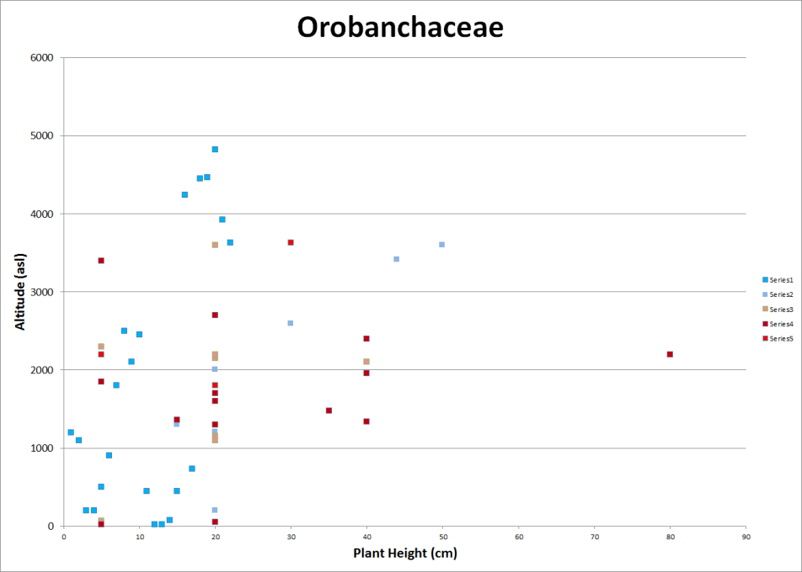
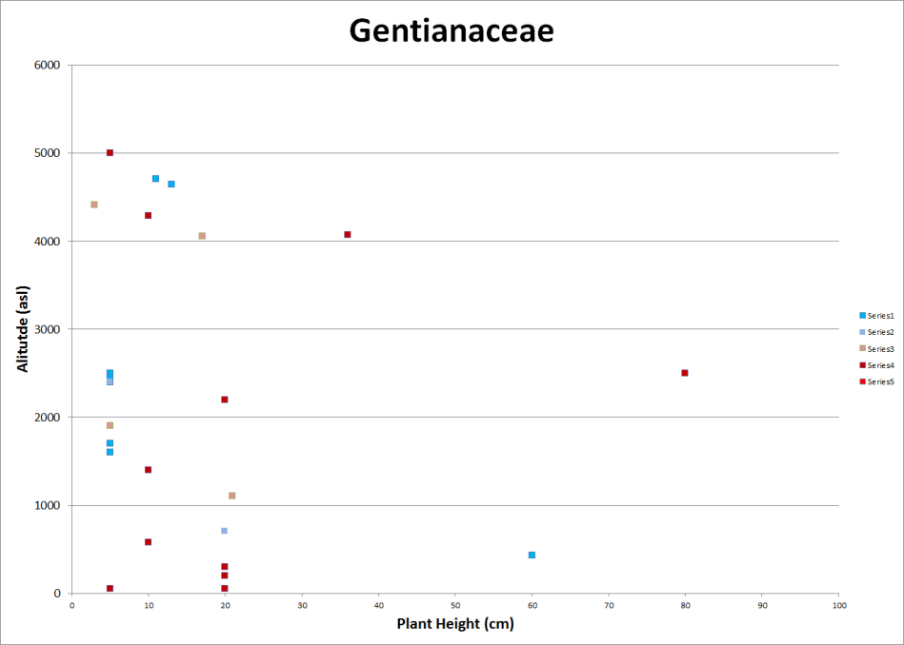

Slide 27
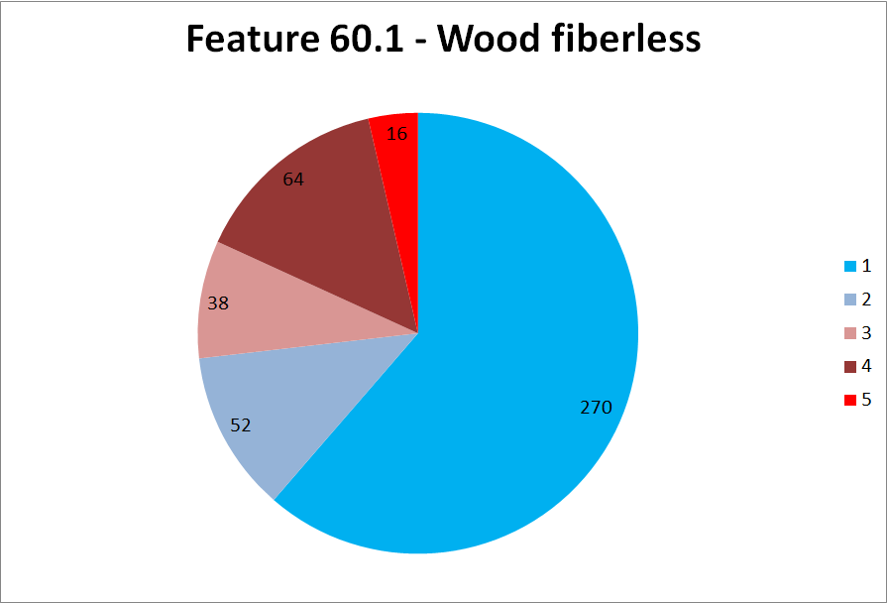
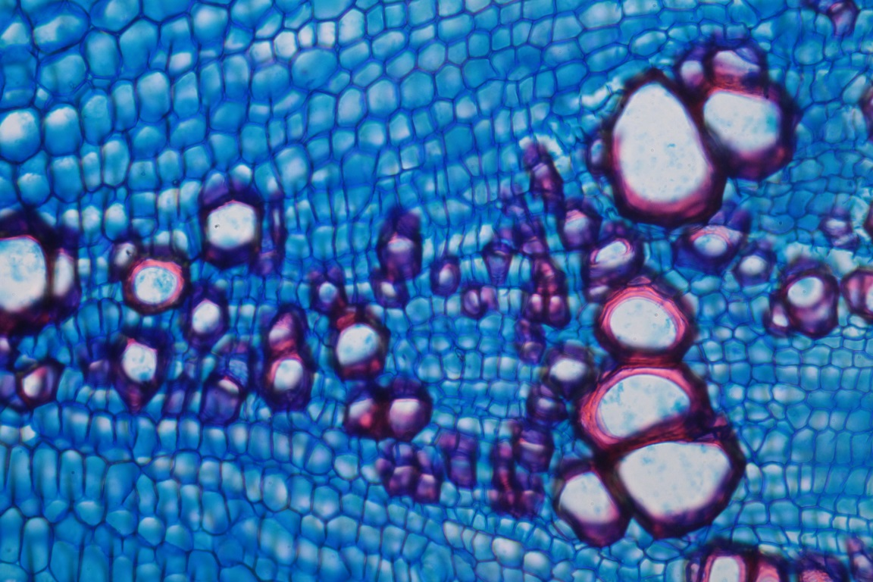




Slide 28
Conclusion
It is possible to recognize lignified and unlignified tissues of plants
That needs to be confirmed by test with Phloroglucinol

Slide 29
Conclusion
Lignification patterns are related to…
vegetation zones / altitude
plant height
taxonomic groups
anatomical features

Slide 30
Future
Staining tests
Quantification of lignin in g/cm3
Calculations of lignin production in relation to…
years
plant speceis
vegetation zones
global picture

